Slide 1
Software Performance Engineering for Object-Oriented Systems: A Use Case Approach
SANKET JAIN – 12BCE081
SHUBHAM RATHI – 12BCE097

Slide 2
Object-Oriented Development
Object-oriented development is an approach to software specification, design and construction that is based on identification of the objects that occur naturally in the application and implementation domains.

Slide 3
Object-Oriented Development
object-oriented methods, scenarios are used to:
Describe the externally visible behaviour of the system,
Support prototyping,
Help in validate the requirements specification,
Understand interactions between objects, and
Support requirements-based testing.

Slide 4
The Role of Analysis and Design
Analysis
Investigating the Boundaries of a Problem
What are the Scope and Requirements?
How is the System Accessed?
Who needs Access to What When?
Determining WHAT needs to be Done!
OO Analysis
Identification of Critical Concepts in the Problem Domain that Correspond
Emphasis on Finding Objects and Components
What is Available to Facilitate OO Analysis?

Slide 5
The Role of Analysis and Design
Design
Development of a Logical Solution
Represents One Way to Solve Problem
Defining HOW System Fulfills WHAT!
OO Design
Emphasis on Defining Logical Software Objects and Components
Evaluate Alternative OO Designs
Leads to Implementation of a Feasible Solution

Slide 6
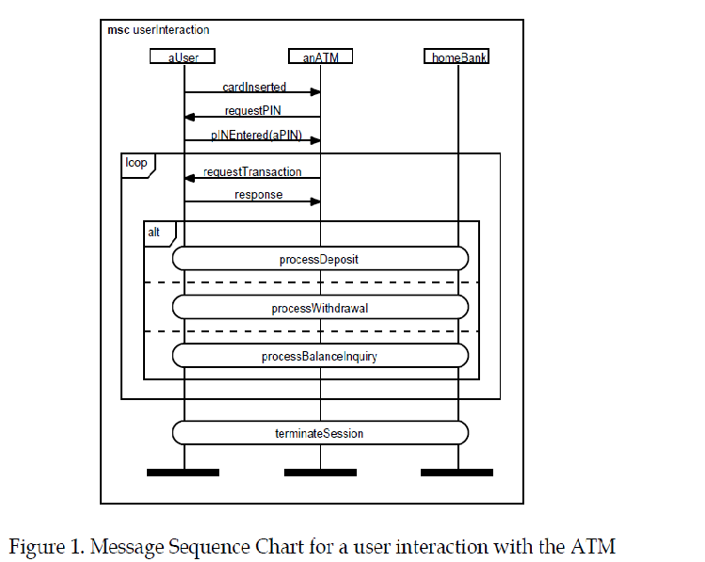
In object-oriented methods, scenarios are used to:
• Describe the externally visible behavior of the system,
• Involve users in the requirements analysis process,
• Support prototyping,
• Help validate the requirements specification,
• Understand interactions between objects, and
• Support requirements-based testing.

Slide 7
UML for Data Mining (DM-UML)
Extension of the UML modelling language for data mining projects (DM-UML)
DM-UML (Data Mining Unified Modelling Language)

Slide 8
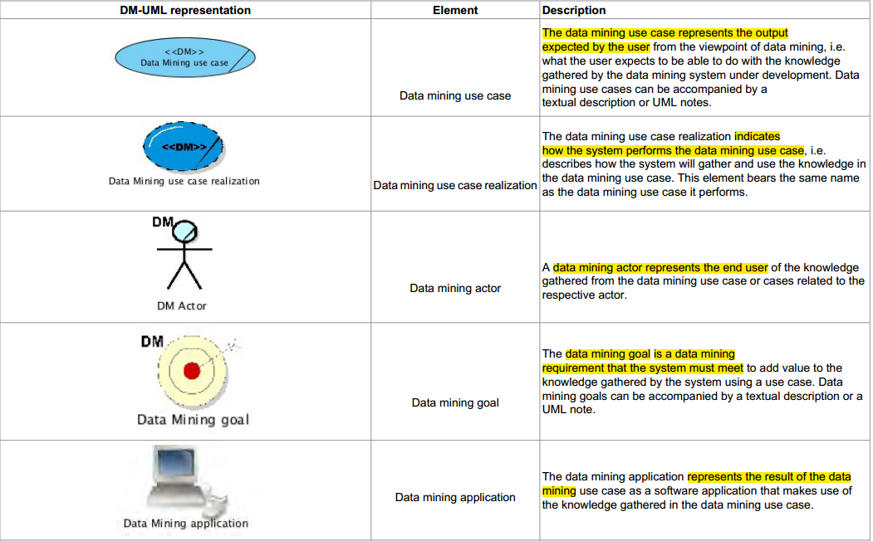

Slide 9
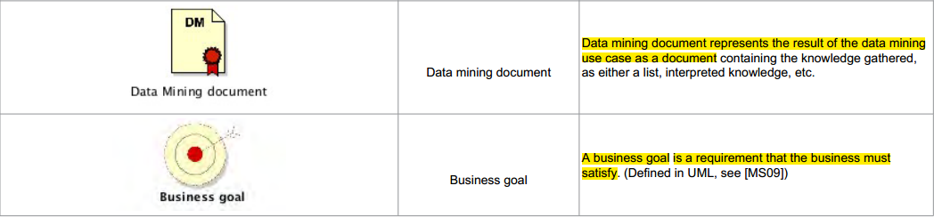
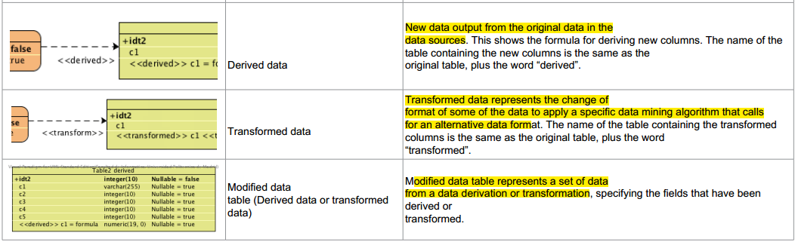

Slide 10
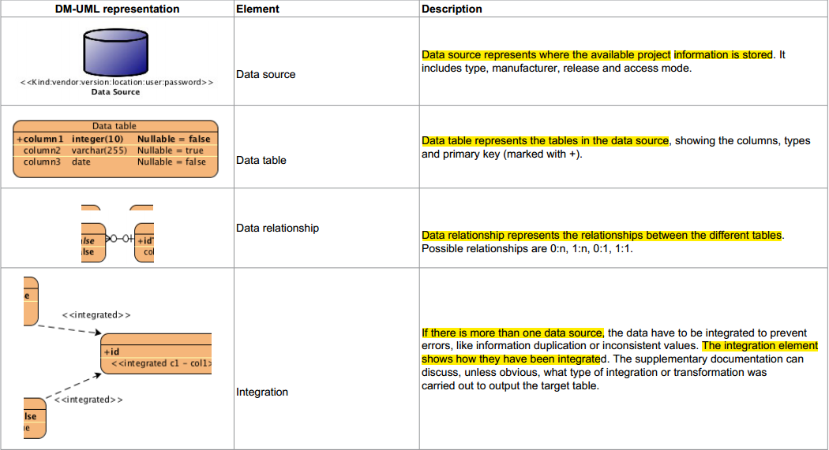

Slide 11
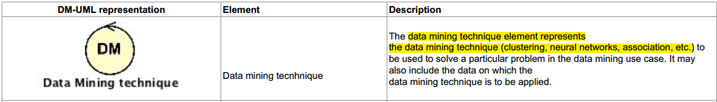
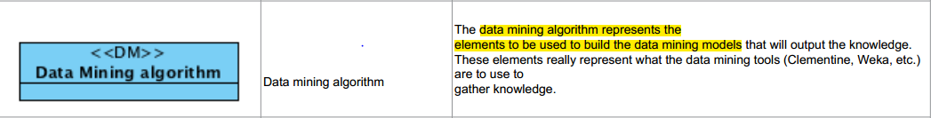

Slide 12
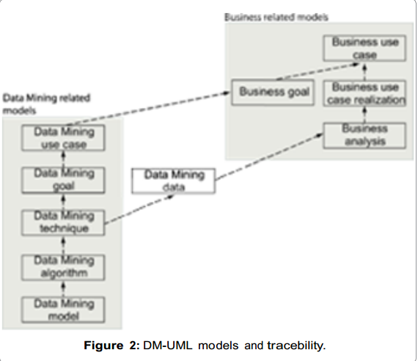

Slide 13
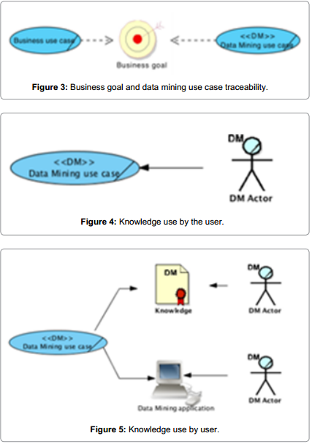

Slide 14
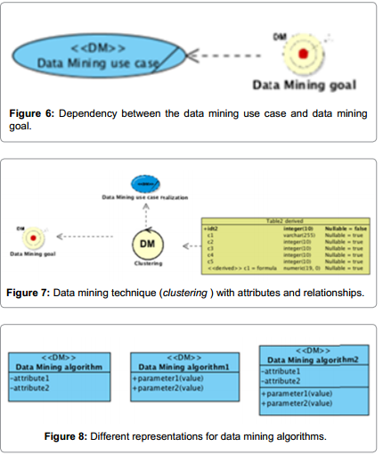

Slide 15
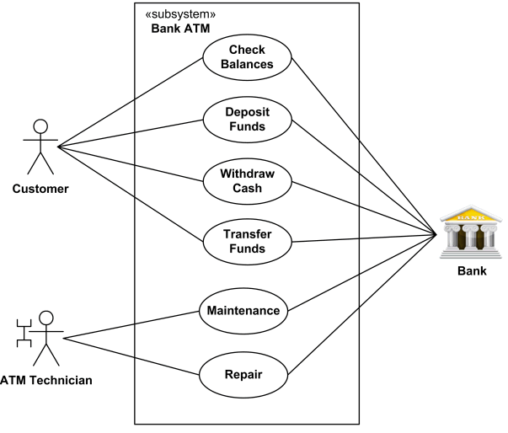
Use Case Approach
A use case is an interaction between users and a system.
The use case model captures the goal of the user and the responsibility of the system to its users.
Graph of Actors and Set of Use Cases Enclosed by System (High-Level) or Class Boundary

Slide 16
Logical View
Implementation View
End-user
Programmers
Software management
Functionality
Use Case View
Process View
Deployment View
System integrators
System engineering
Performance
Scalability
Throughput
System topology
Delivery, installation
Communication

Slide 17
Software Performance Engineering
Software performance engineering is a quantitative approach to constructing software systems that meet performance objectives.
SPE prescribes principles for creating responsive software, the data required for evaluation, procedures for obtaining performance specifications, and guidelines for the types of evaluation to be conducted at each development stage.

Slide 18
A. Software Execution Model
The software execution model represents key aspects of the software execution behavior.
Solving software model provides:
A static analysis of the mean, best- and worst case response times.
It characterizes the resource requirements of the proposed software alone, in the absence of other workloads, multiple users or delays due to contention for resources.

Slide 19
B. System Execution Model
This model is a dynamic model that characterizes the software performance in the presence of factors, such as other workloads or multiple users that could cause contention for resources.
The results obtained by solving the software execution model provide input parameters for the system execution model.
Solving the system execution model provides following additional information:
More precise metrics that account for resource contention.
Sensitivity of performance metrics to variations in workload composition.
Effect of new software on service level objectives of other systems.
Identification of bottleneck resources.
Comparative data on options for improving performance via: workload changes, software changes, hardware upgrades, and various combinations of each.

Slide 20
SPE for OOD
Establish performance objectives.
Identify important Use Cases.
Select key performance scenarios.
Translate scenarios to execution graphs.
Add resource requirements.
Solve the models.

Slide 21
THANK YOU

